Slide 1

Intro to R
R 101

Slide 2
OVERVIEW
R basics
Data cleaning using tidyverse
Resources

Slide 3

WHAT IS R?
a calculator
a suite of statistical tools
a graphics creator
a programming language
a simulation lab
## It is uniquely suited to epidemiological analysis ##

Slide 4

WHAT R IS NOT
easy and intuitive (initially)
a Graphical User Interface (GUI) experience
You will require RStudio for this
a database management system (DBMS)

Slide 5
R Basics

Slide 6
OVERVIEW
R basics
Installing R
Navigating the interface
Working directory & R projects
Base R & Packages
Importing & exporting data
Data cleaning using tidyverse
Resources

Slide 7
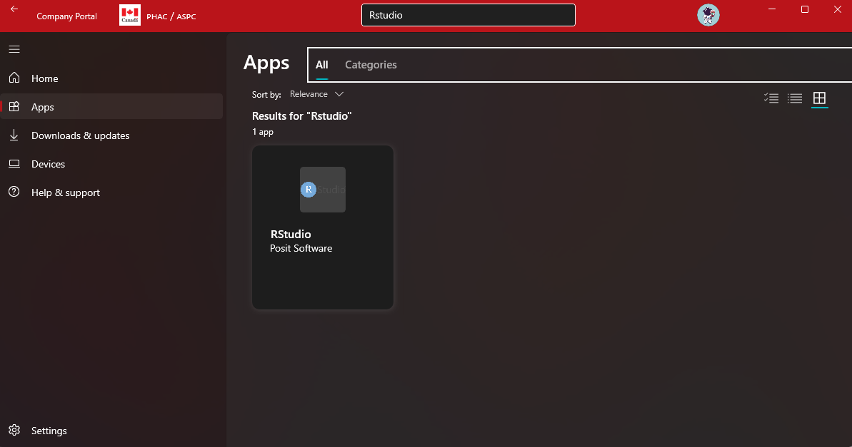
Installation
Company Portal Link

Slide 8
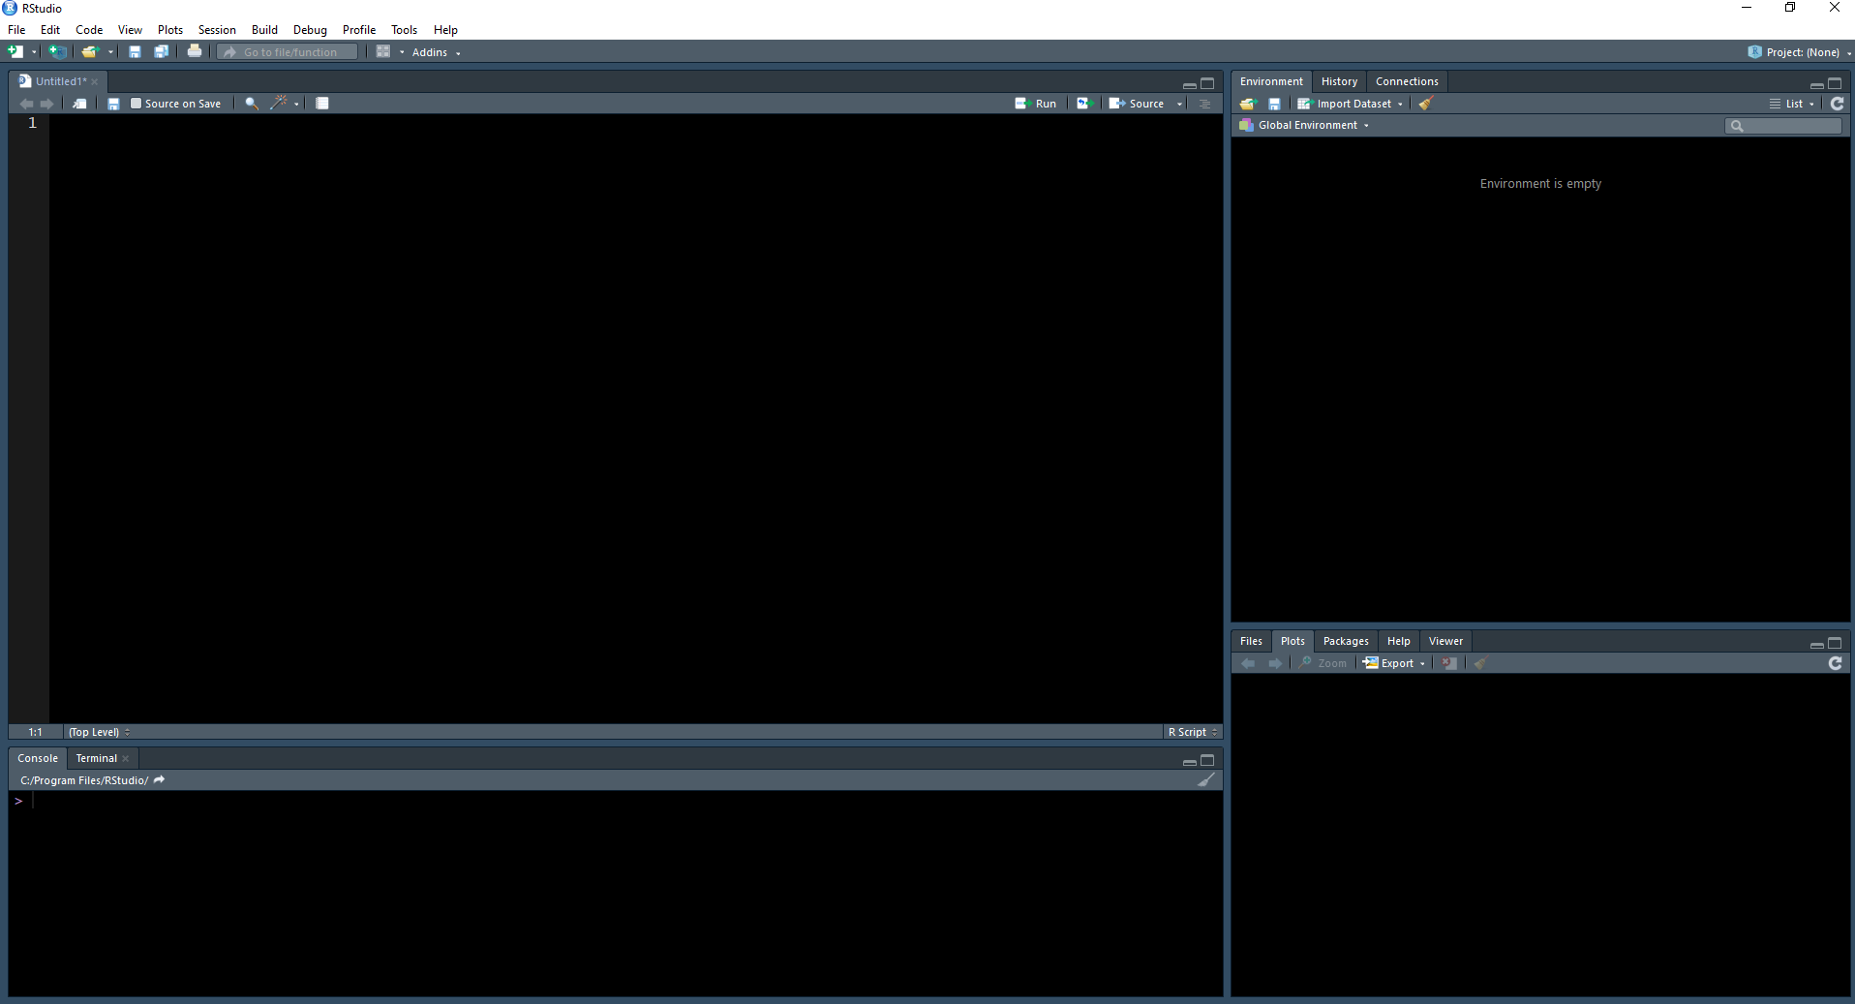
SCRIPT
ENVIRONMENT
PLOTS, VIEWER…
CONSOLE

Slide 9
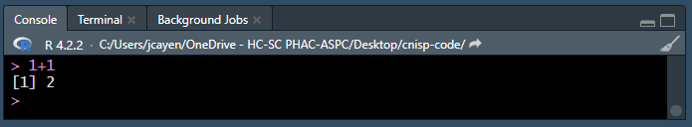
console
Navigating the interface
The console is the most basic way to interact with R. You can type a command to R
into the console prompt (the prompt looks like “>”) and R will respond to what you type. For example, below I’ve typed “1 plus 1,” hit enter, and the R console returned the sum of the numbers 1 and 1.

Slide 10
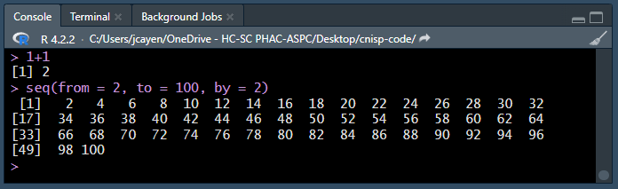
The number 1 you see in brackets before the 2 (i.e., [1]) is telling you that this line of results starts with the first result. That fact is obvious here because there is only one result. To make this idea clearer, let’s show you a result with multiple lines.
console
The first line of results starts with a 1 in brackets (i.e., [1]), which indicates that this line of results starts with the first result. In this case the first result is the number 2. The second line of results starts with a 17 in brackets (i.e., [17]), which indicates that this line of results starts with the seventeenth result. In this case the seventeenth result is the number 34. If you count the numbers in the first line, there should be 16 – results 1 through 16.
The second new thing here that you may have noticed is our use of a function. Functions are a BIG DEAL in R. So much so that R is called a functional language.

Slide 11
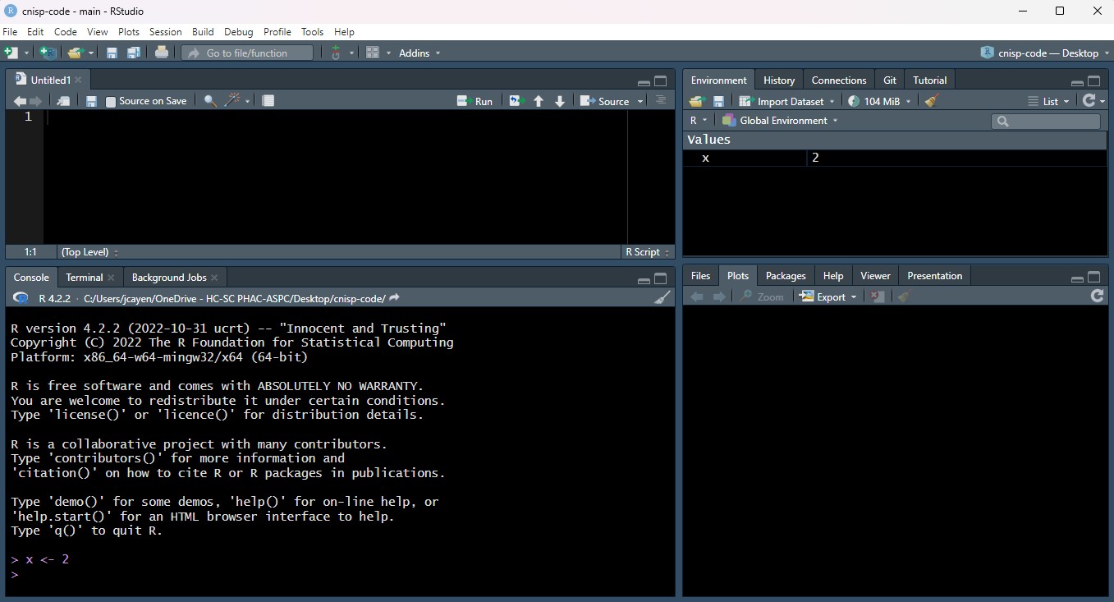
environment
environment
Navigating the interface
The Environment pane shows you all the objects that R can currently use for data
management or analysis.

Slide 12
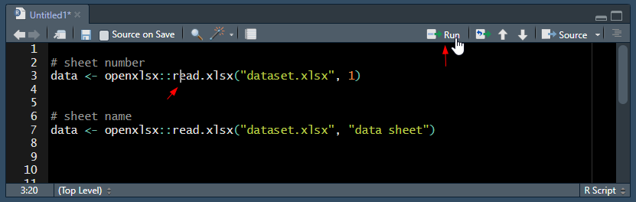
script
Navigating the interface
To run code from a script there are a couple options:
Click “Run” button
Hit “Ctrl” + “Enter”
Clicking the run button (or hitting Ctrl + Enter) will run the current line of code where the cursor is.
If you highlight multiple lines you can run them all

Slide 13


Working directory
The working directory is the default location where R will look for files you want to load and where it will put any files you save. You can check the file path of your working directory by looking at bar at the top of the Console pane. You can also use the getwd() function in the Console which returns the file path of the current working directory
If you want, you can set your working directory using the setwd() function at the start of every R script. Or you can specify the filepath when you import/export data.

Slide 14
R projects
DISCLAIMER – R projects may be deprecated
An R project enables your work to be bundled in a portable, self-contained folder. Within the project, all the relevant scripts, data files, figures/outputs, and history are stored in sub-folders and importantly – the working directory is the project’s root folder.
A common, efficient, and trouble-free way to use R is to combine there 3 elements:
1. An R project
- A self-contained working environment with folders for data, scripts, outputs…
2. The here package
- Filepaths are written relative to the root folder of the R project
3. The rio package for importing/exporting
- import() and export() handle any file type by its extension (e.g. .csv, .xlsx, .png)

Slide 15
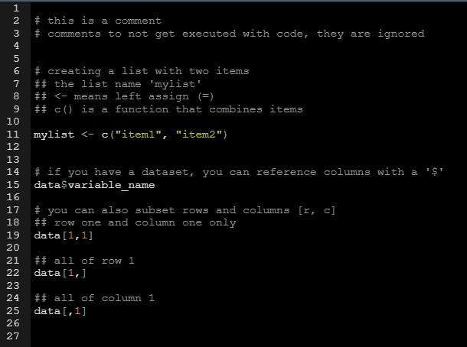
Base R
A few notes on R's language

Slide 16
script
Navigating the interface
Scripts are a fundamental part of programming. They are documents that hold your commands (e.g. functions to create and modify datasets, print visualizations, etc). You can save a script and run it again later. There are many advantages to storing and running your commands from a script (vs. typing commands one-by-one into the R console “command line”):
Portability – you can share your work with others by sending them your scripts
Reproducibility – so that you and others know exactly what you did
Version control – so you can track changes made by yourself or colleagues
Commenting/annotation – to explain to your colleagues (or your future self) what you have done

Slide 17
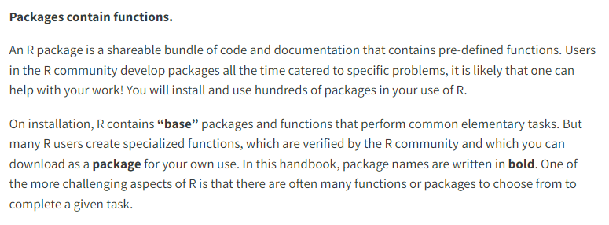
Packages

Slide 18
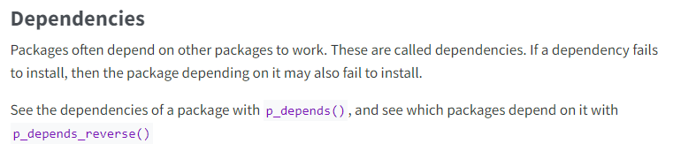
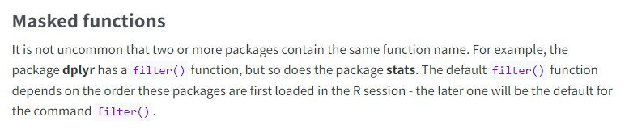
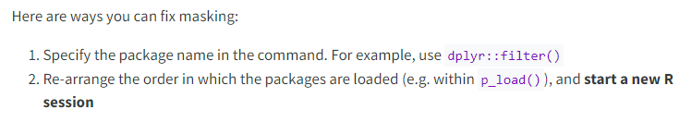

Slide 19
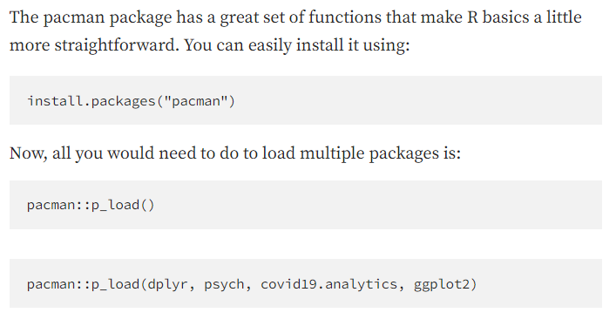
pacman::p_load()

Slide 20
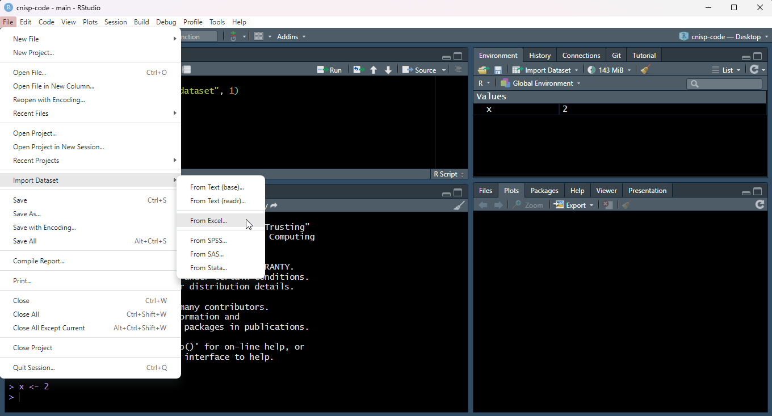
Importing data
Click and point

Slide 21
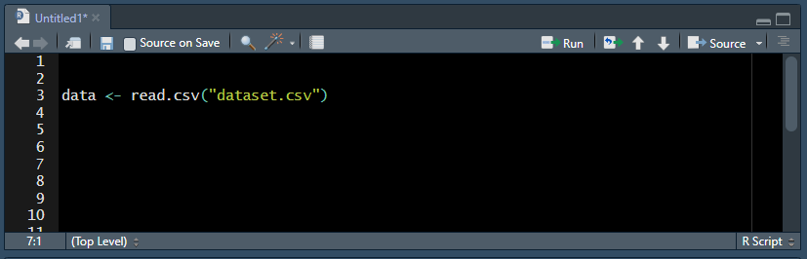
csv
Importing data - csv
2. Code
If file is in working directory
If using file path, slashes need to be reversed "/" instead of "\" or doubled “\\”
If referring to file outside of working directory

Slide 22
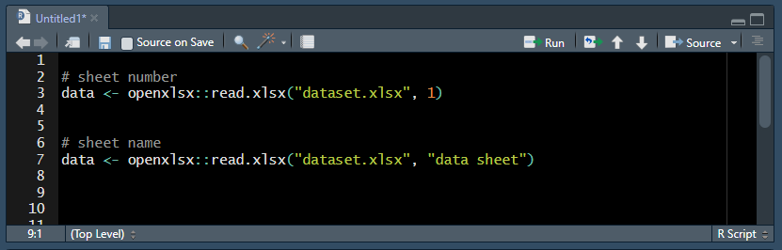
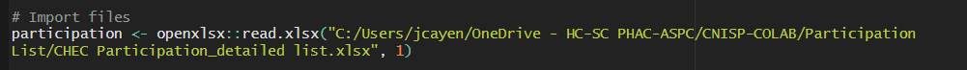
excel
Importing data - excel
If file is in working directory
2. Code
File name in first set of quotations, sheet name in second set of quotations or sheet number
If using file path, slashes need to be reversed "/" instead of "\" or doubled “\\”
If referring to file outside of working directory

Slide 23
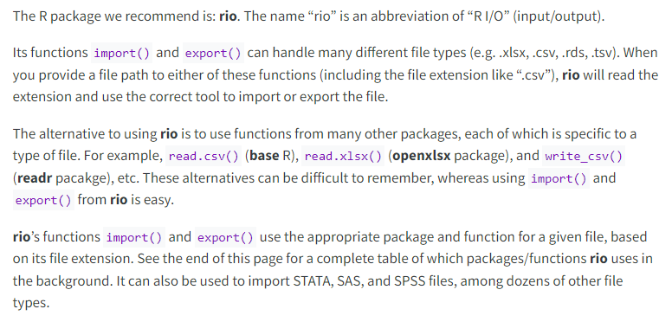

Slide 24
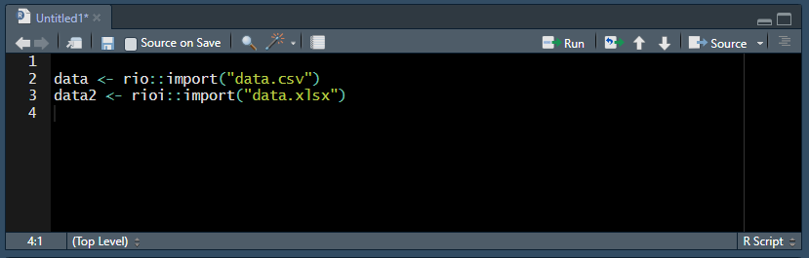
All types
Importing data – all types
2. Code
If file is in working directory
If using file path, slashes need to be reversed "/" instead of "\" or doubled “\\”
If referring to file outside of working directory

Slide 25
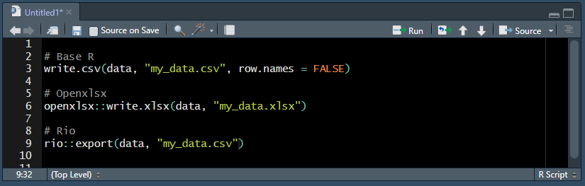
Exporting data
All types
If using file path, slashes need to be reversed "/" instead of "\" or doubled “\\”
If referring to file outside of working directory

Slide 26
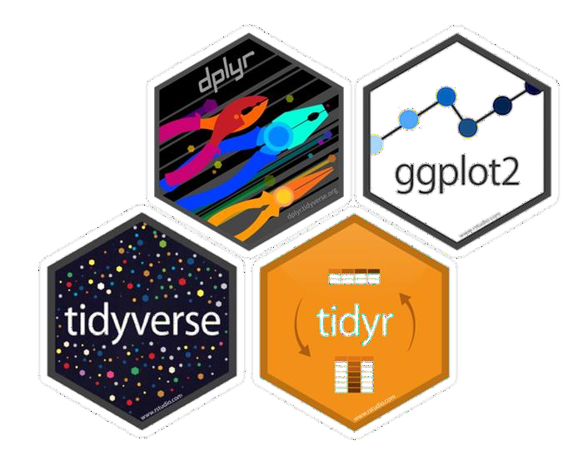





The tidyverse:
https://www.tidyverse.org/packages/
https://datacarpentry.github.io/r-socialsci/index.html

Slide 27
OVERVIEW
R basics
Data cleaning using tidyverse
dplyr (filter, select, mutate, group_by, summarize)
tidyr (pivot_wider, pivot_longer)
stringr (str_detect, str_sub, str_extract_all)
Resources

Slide 28
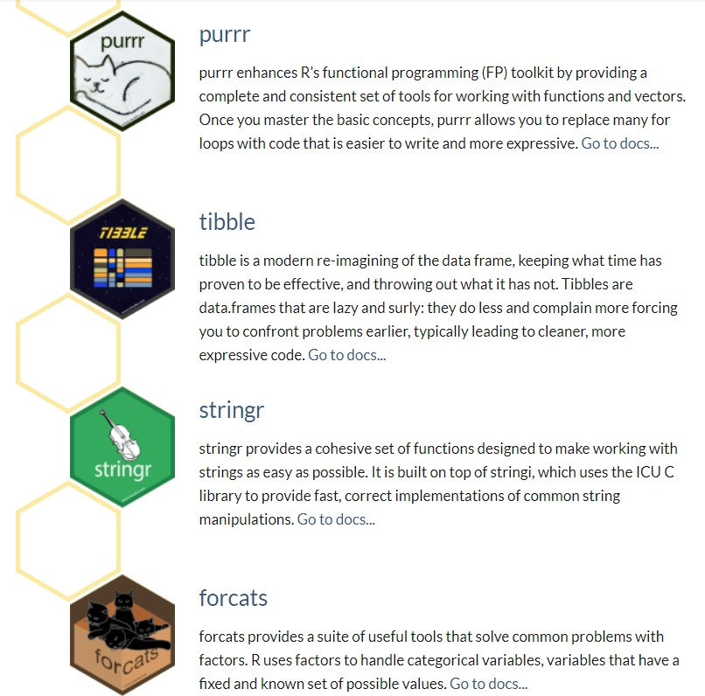
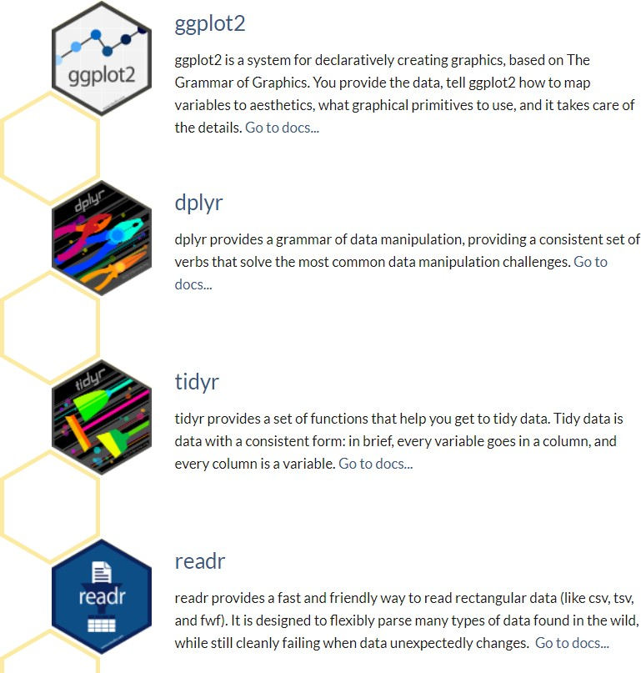
Tidyverse

Slide 29
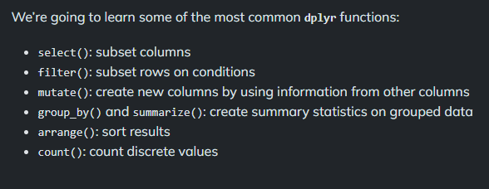
dplyr

Slide 30


The pipe %>%
We often want to string together a series of dplyr functions. This is achieved using dplyr’s pipe operator, %>%. This takes the value on the left, and passes it as the first argument to the function call on the right.

Slide 31
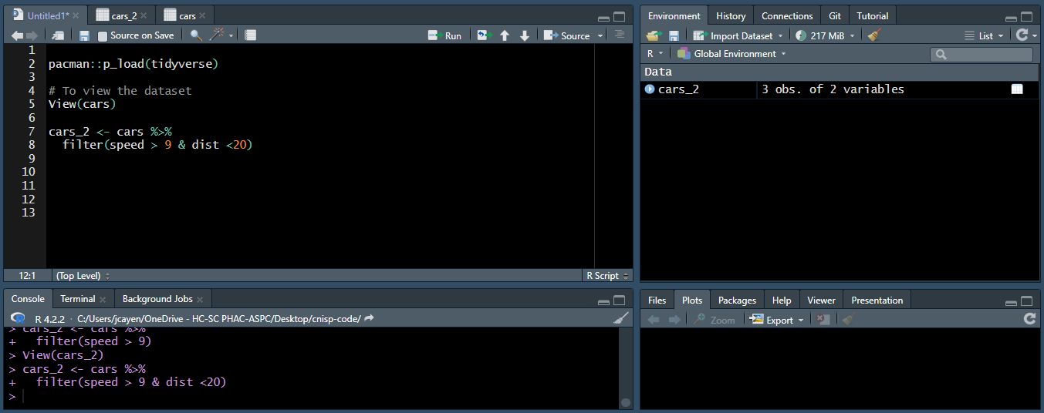
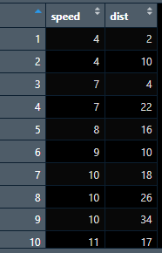
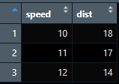
filter()
# dplyr’s filter function is for subsetting rows/observations conditionally.
cars
cars_2

Slide 32
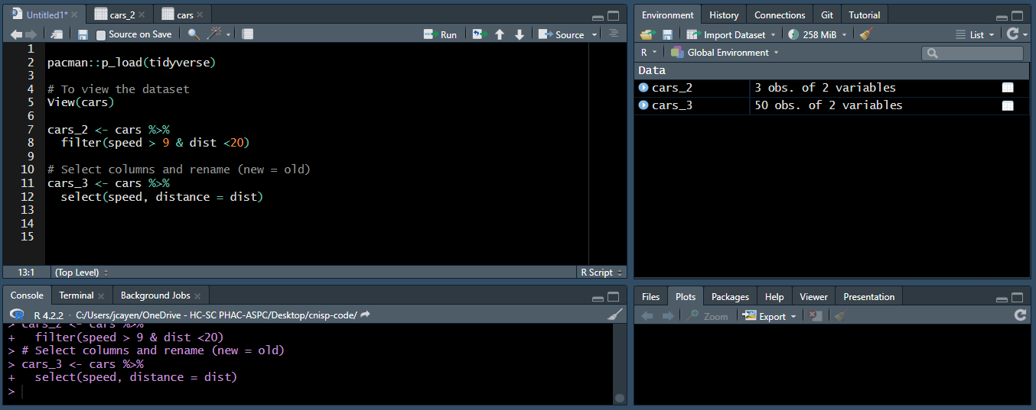
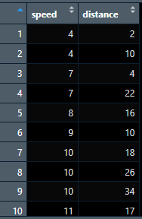
select()
# dplyr’s select function is for subsetting, renaming, and reordering columns. # old columns can be referred to by name or by number.
cars_3

Slide 33
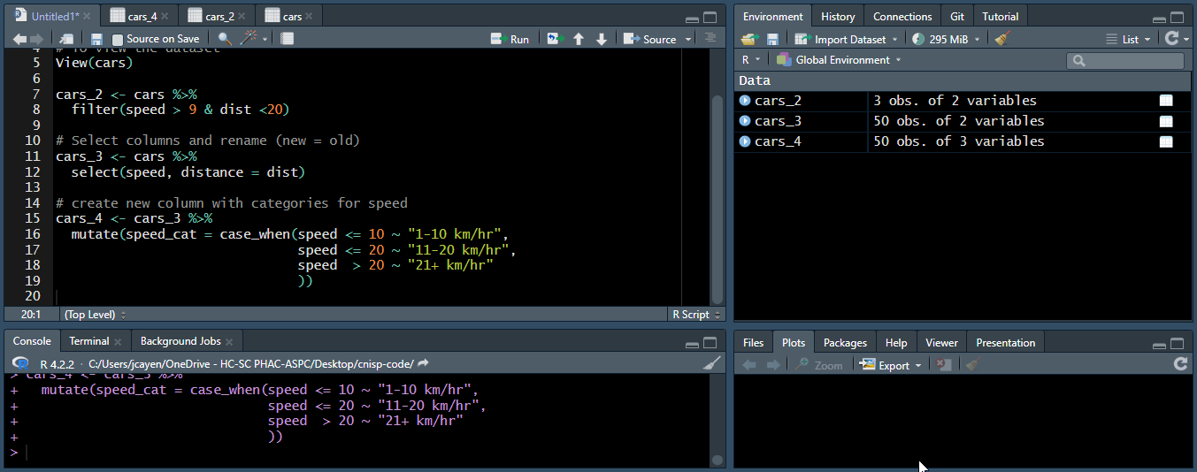
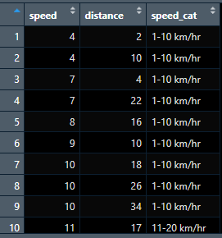
mutate()
# mutate lets us add or overwrite columns by computing a new value for them.
cars_4
NA_real_ for numeric variables NA_character_ for character variables

Slide 34
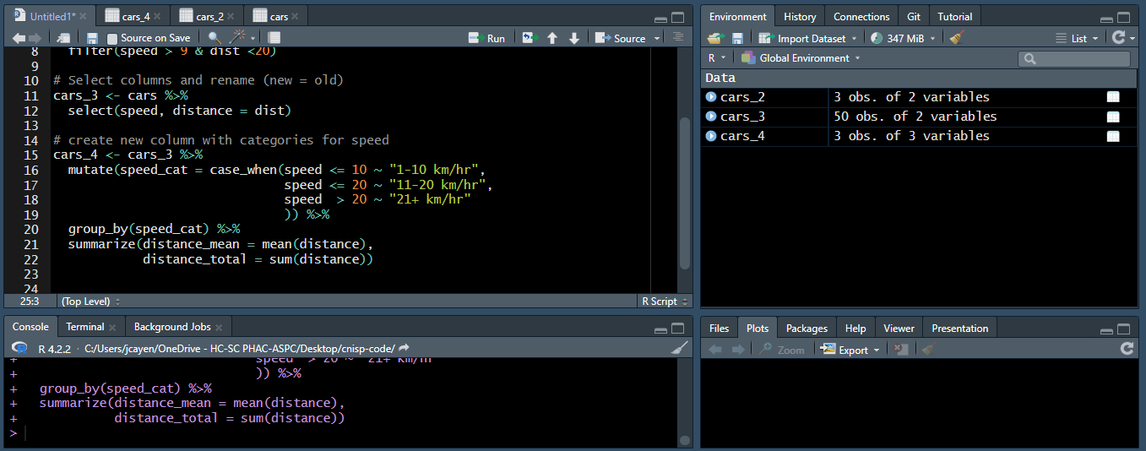
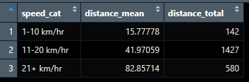
summarize()
# summarize lets us compute summaries of data.
cars_4

Slide 35
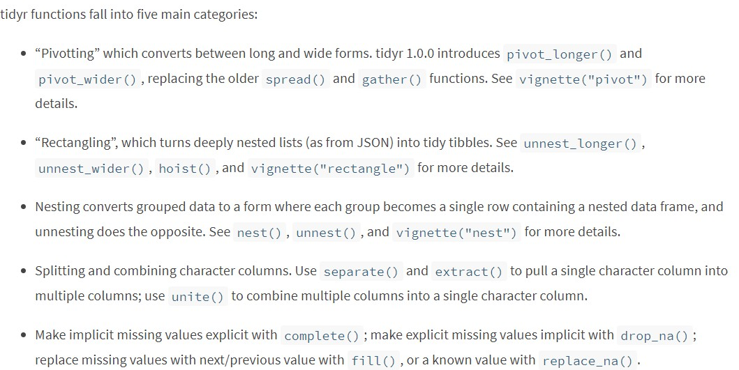
tidyr

Slide 36

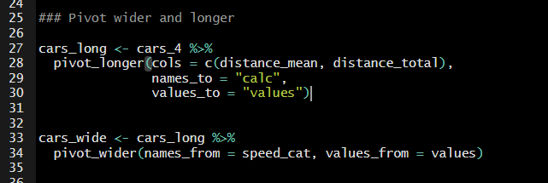
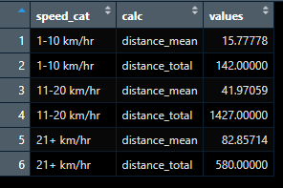
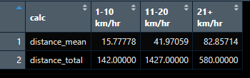
pivot_longer()
# pivot_longer() "lengthens" data, increasing the number of rows and decreasing the number of columns. The inverse transformation is pivot_wider()
cars_long
cars_4
cars_wide

Slide 37

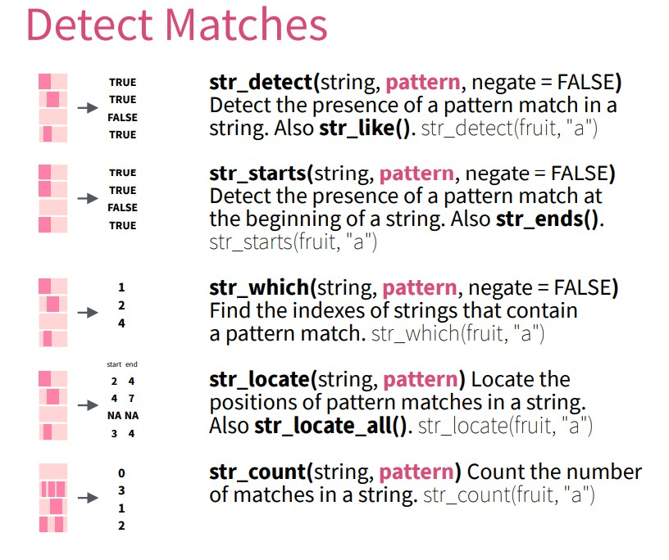
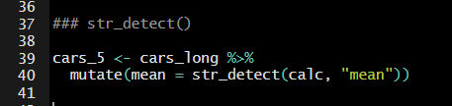
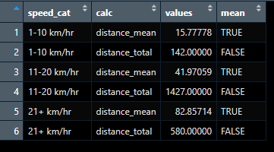
stringr

Slide 38
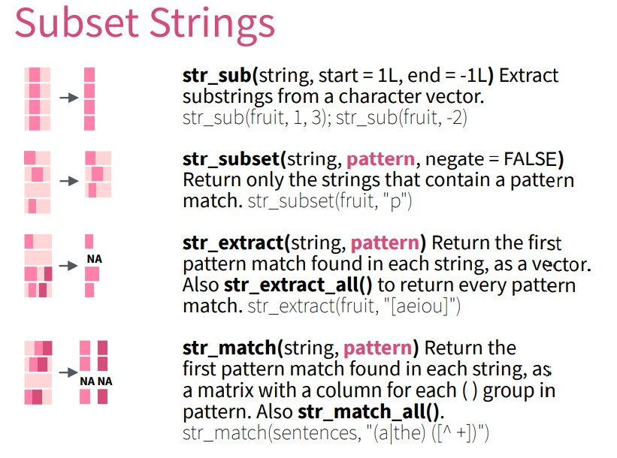
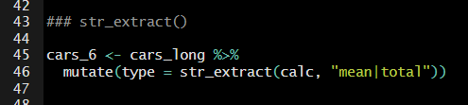
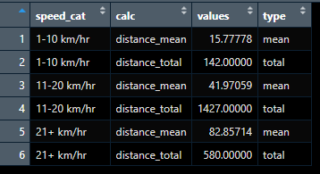

Slide 39
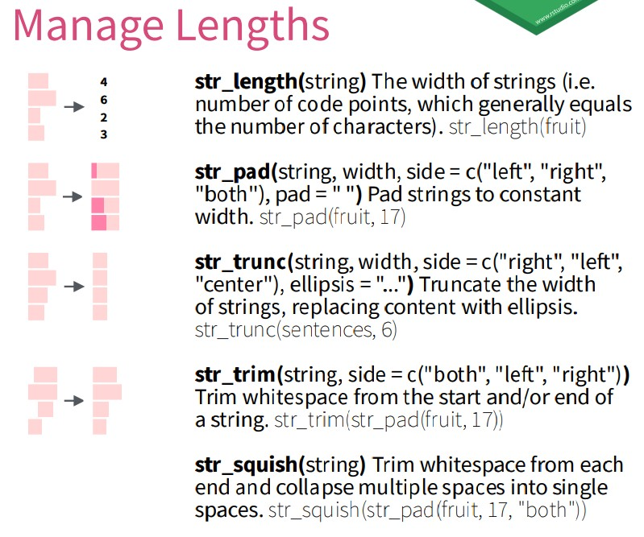
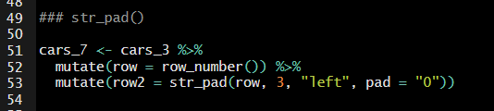
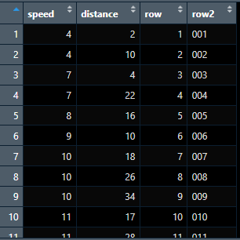

Slide 40
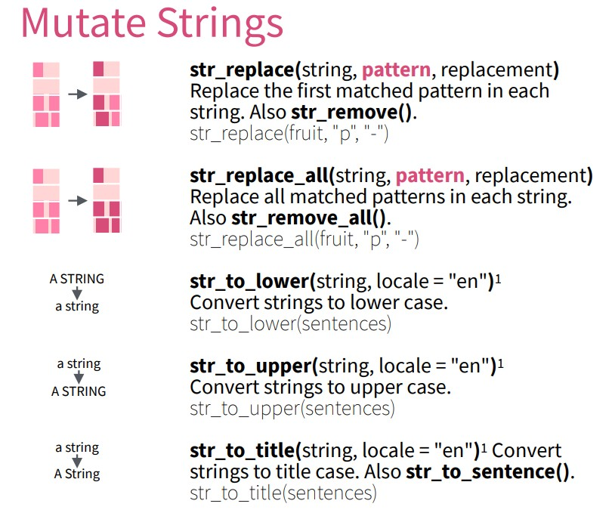
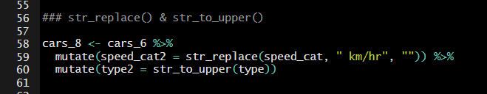
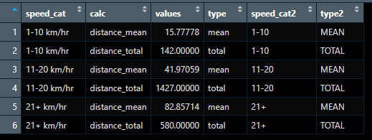

Slide 41
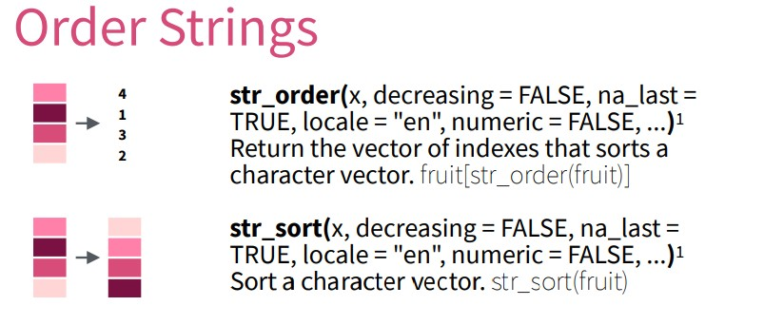
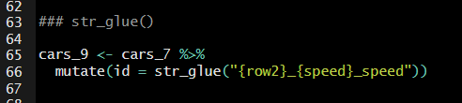




Slide 42
Resources
Swirl tutorial package (https://swirlstats.com/)
Epi’s handbook (https://www.epirhandbook.com/en/)
R4Epi (https://www.r4epi.com/)
Intro to R for epi’s free course (https://ucb-epi-r.github.io/)
R for data science (https://r4ds.hadley.nz/)
R for SAS users (https://posit.co/blog/how-to-learn-r-as-a-sas-user/)
SAS to R cheat sheet (https://pharmaverse.github.io/intro-to-r-for-sas-programmers-workshop/)
Intro to Tidyverse (https://jhudatascience.org/tidyversecourse/intro.html)

Slide 43

https://s3.amazonaws.com/assets.datacamp.com/blog_assets/T
idyverse+Cheat+Sheet.pdf
CHEAT SHEET

